Slide 1

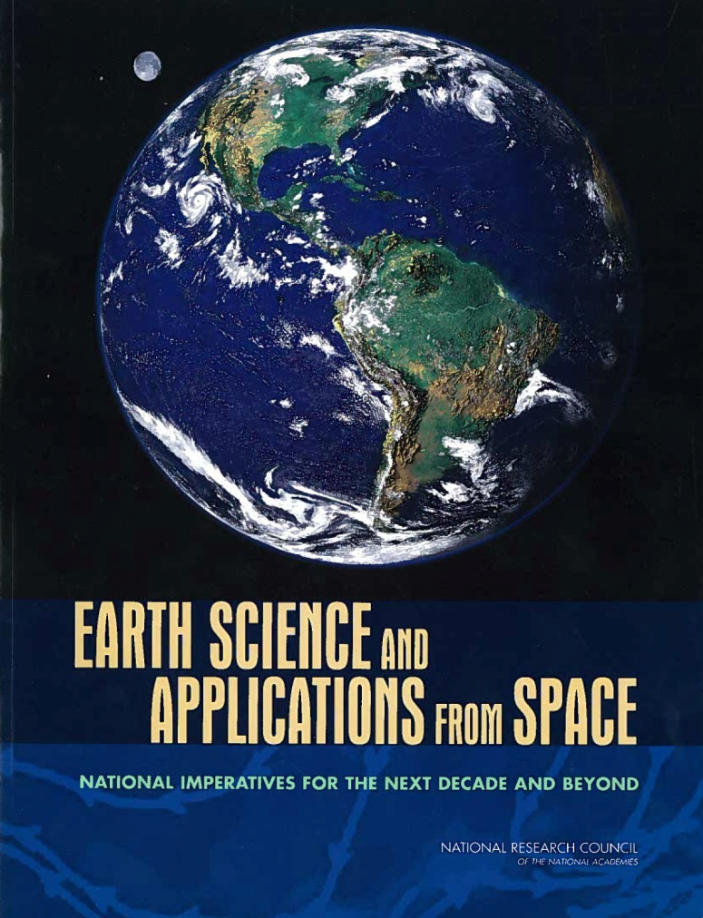
Earth Science Decadal Surveys:
Lessons from the 1st
Expectations for the 2nd
Preparations
Stephen Volz
Association Director, Flight Programs
9 September 2013

Slide 2
Thursday, May 8
8:30AM Project Talks (12 minutes each plus 3 minutes for questions)
Global Population Dynamics and Climate Change: Comparing Species-level Impacts on Two Contrasting Large Mammals
Farshid Ahrestani/University of Montana
Genetic Programming for Ocean Microbial Ecology and Biodiversity
John Moisan/NASA Wallops Flight Facility
Assembly and Evolution of the Amazonian Biota and its Environment: An Integrated Approach
Kyle McDonald/City University of New York
Sensitivity of Coastal Zone Ecosystems to Climate Change
Kyle Cavanaugh/Smithsonian Institution
9:30AM Additional Questions and Discussion
9:45AM Project Talks (12 minutes each plus 3 minutes for questions)
Adding Phylogeny to GIS-enabled Species Range and Distribution Analyses
Jeffery Cavner/University of Kansas
Extending the Terrestrial Observation and Prediction System (TOPS) to the Suomi NPP Mission
Jennifer Dungan/NASA Ames Research Center
Essential Biodiversity Variables (EBVs) and Mission Needs
Gary Geller/Jet Propulsion Laboratory
10:30AM Additional Questions and Discussion
10:45AM Break
11:05AM Special Session: Preparing for the Next Decadal Survey
The Earth Science Decadal Survey: What is it, Why NASA does it, How NASA uses it—And how should your community prepare for it?
Steve Volz/NASA ESD
11:35AM Questions, Comments, and Discussion
1:45PM Parallel Breakout Sessions: Preparing the Biodiversity and Ecological Forecasting Communities for the Earth Science Decadal Survey—Getting to Missions through Designation of Key Topics

Slide 3
OUTLINE
NASA Earth Science Before the Decadal Survey
1st NRC Decadal Survey Recommendations
NASA Earth Science Implementation & Progress
Earth Science Projections into the future
Notes:
3

Slide 4
NASA & US Earth Science in 2007 When the 1st Decadal Survey was released
NASA Earth Science Situation:
15 missions in operation:
  Jason-1, ACRIMSAT, Aura, Aqua, Terra, CALIPSO, CloudSat, GRACE, QuikSCAT, Landsat 7, TRMM, EO-1, SORCE, ICESat
7 Legacy missions in development:
  Jason-2/OSTM, OCO, Glory, Aquarius/SAC-D, NPP, LDCM, GPM (Core+LIO)
No competitive flight program (no ESSP solicitations)
FY2007 ESD budget request was ~$1.45B
  Budget split ~55%/45% split between Flight/non-Flight
  ~1000 flight hours for the year for the Airborne Science Program
Other USG Agency Earth Observations:
NPOESS Program in full swing, designed to support long term climate measurements, starting in 2012
GOES-R and –S planned for early 2010s launch
DMSP program healthy and operating
Notes:
4

Slide 5
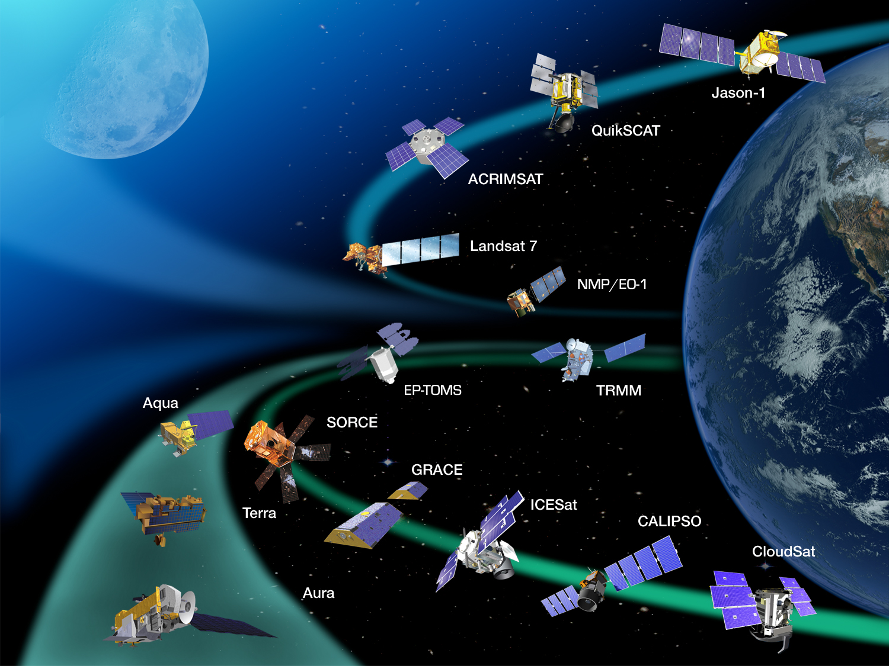
15 NASA Earth Science Missions
Operating in 2007
Chart from January 2007

Slide 6
NRC Decadal Survey Recommendation
Re-invigorate on-orbit constellation – launch 8 legacy missions
Preserve programmatic balance between flight and non-flight, with technology, airborne science, and applied sciences
Embark on 15 new missions in 3 time phased tiers
Institute competitive flight program (Venture-Class)
Increase use of airborne science program
Increase ESD budget by 30-40% (to $2B/year [FY07 $$] by 2010)
Implement missions in a more cost-effective way, while preserving NASA core expertise
Notes:
6

Slide 7
NASA Approach to Mission Development
For Missions in Operation
  Continue to operate safely and efficiently
  Ensure maximum return from measurements and data products already on line
  Ensure the long term integrity of the data records
For Missions in Development & Formulation
  Ensure timely maturation of any technology elements
  Maintain rigor on requirements implementation (no mission creep!)
  Ensure projects stay within their defined budget parameters and stay on schedule
For Mission concepts in pre-formulation
Develop detailed understanding of the mission concepts to allow for future planning
Prepare the mission concepts for entry into formulation and development
Coordinate with Research and Earth Science Technology programs to share investments

Slide 8
NASA Earth Science Accomplishments: 2007 – May 2014
NASA
7 Legacy Missions Launched (4 successfully)
    OSTM – 6/20/08; OCO – 2/24/09; Glory – 3/4/11; Aquarius – 6/10/11; S-NPP – 10/28/11; LDCM – 2/11/13; GPM – 2/27/14
4 Additional missions launching in 2014: OCO-2 (7/14), RapidScat (8/14), CATS (9/14), SMAP (11/14)
8 additional missions funded for launch by 2021 (SAGE III, CYGNSS, ICESat-2, TEMPO, GRACE-FO, SWOT, NI-SAR, PACE)
Significant investments ($300M - $400M) in remaining Tier I & II DS missions (HyspIRI, GEO-CAPE, ACE, ASCENDS, CLARREO)
Airborne hours increased >2.5x, including ICEBridge, EVS-1
Venture-Class funded, three selections made, 2 additional selections expected in 2014
Budget increased from ~$1.45B/year to ~$1.8B/year
Other USG
NPOESS Cancelled, JPSS-1 and -2 delayed 5+ years, launches in 2017 & 2022
  Climate sensors delayed or demanifested
GOES-R, -S delayed to late 2010s
AF Weather Program discontinued after DMSP-20
Launch Failed
Launch Failed
Notes:
8

Slide 9
2007 – 2013 Overall Flight Program Accomplishments and Critical Events
2007
1st Decadal Survey released
NASA develops plan for flight & non-flight elements
2008
SMAP and ICESat-2 studies started
Plans established for other Tier I and II missions
ESTO solicitations focused on DS recommendations
2009
SMAP & ICESat-2 enter Phase A
Earth Venture-1 AO released
OCO launch vehicle failure
DS Mission workshop held
2010
NASA releases Climate Plan
GRACE FO, SAGE III, OCO-3, PACE studies initiated
5 EV-1 investigations selected
OCO-2 enters Phase C
1st annual DS mission study review
2011
Glory launch vehicle failure
Aquarius & S-NPP launches
SMAP & ICESat-2 in Phase B
SAGE III enters Phase A
2nd annual DS mission study review
2012
GRACE FO enters Phase A
EVM-1 Selected, CYGNSS enters Phase A
EVI-1 Selected, TEMPO enters Phase A
SAGE III, SMAP, ICESat-2 enter Phase C
PACE SDT report released
OCO-3, SWOT enter Phase A
4th annual DS mission study review
2013
LDCM/Landsat 8 Launch
EVI-2, EVS-2 solicitations released
SAGE III CDR & then launch delay
ICESat-2 replanning
NISAR partnership defined
4th annual DS mission study review
RED indicates transition of each of 9 flight systems entering into Development
BLUE indicates 5 mission launches

Slide 10
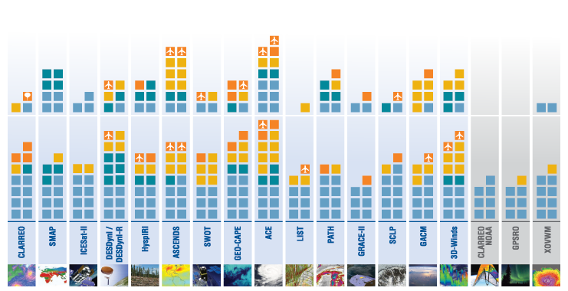
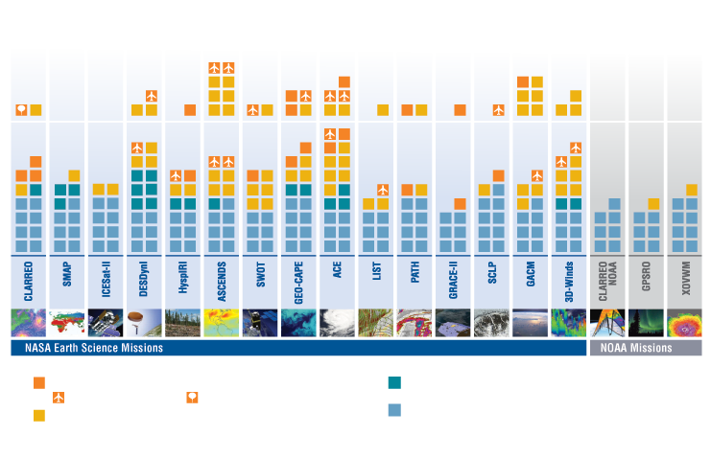
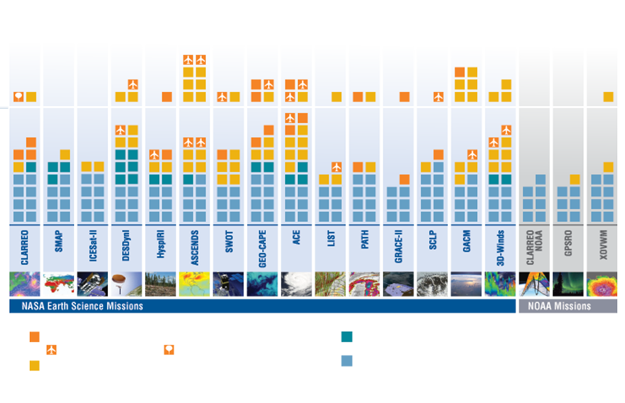
Earth Science Technology:
New Investments Enabling the Decadal Survey
Upon publication of the Earth Science Decadal Survey in 2007, ESTO investments already supported all 18 of the recommended mission concepts. Since then, ESTO has awarded 107 additional technology projects representing an investment of over $211M directly related to the Earth Science priorities outlined by the Decadal Survey.
Technology Addressed by Flight & ESTO
Technology Addressed by ESTO Only
2010 - 2012
Approach through 2012
2007 - 2009
Tier I
Tier II
Tier III
Instrument Technology Investments
Information Systems Investments – Direct Applicability
planned aircraft testing
planned balloon testing
Component Technology Investments
Information Systems Investments – Secondary Applicability
(note: component and information systems investments may apply to more than one mission)

Slide 11
An Assessment of NASA’s Earth Science Programs
Earth Decadal Survey Mid-Term Report
Dennis Hartmann, Committee Chair
University of Washington
Art Charo, Study Director
Lewis Groswald, Research Associate
National Research Council-Space Studies Board
Released in 2012

Slide 12
Findings
Finding: NASA responded favorably and aggressively to the decadal survey, embracing its overall recommendations for Earth observations, missions, technology investments, and priorities for the underlying science. As a consequence, the scientific and applications communities have made significant progress over the past 5 years.

Slide 13
Findings (Cont’d)
Finding: The suborbital program
and, in particular, the Airborne
Science Program, is highly
synergistic with upcoming Earth
science satellite missions and is
being well implemented. NASA has
fulfilled the recommendation of
the decadal survey to enhance the program.
Finding: NASA has maintained a healthy investment in R&A activities and has protected the budgets of both mission-specific and non-mission-specific R&A programs against possible reallocation to cover cost growth in mission hardware.

Slide 14
Airborne Science Program Flight Hours

Slide 15
Findings (Cont’d)
Finding: The Earth Venture class program is being well implemented by NASA and is a crucial component of fulfilling the decadal survey’s objectives.
Finding: Alternative platforms and flight formations offer programmatic flexibility. In some cases, they may be employed to lower the cost of meeting science objectives and/or maturing remote sensing and in situ observing technologies.
Finding: NASA has made considerable efforts to secure international partnerships to meet its scientific goals and operational requirements.
Finding: Aligned with the intent of the decadal survey, NASA’s Applied Sciences Program has begun to engage applied researchers and governmental (federal and state) operational users on some survey mission science definition and applications teams and conduct research to better understand the value of these applications.

Slide 16
Earth Science Division’s Venture Program
EVM Complete, self-contained, small missions
EVI
Full function, facility-class instruments Missions of Opportunity (MoO)
EVS
Sustained Sub-Orbital Investigations
Venture-Class is a Tier-I Decadal Survey recommendation
  Science-driven, PI-led, competitively selected, cost- and schedule-constrained, regularly solicited, orbital and suborbital
  Venture-class investigations may complement the systematic missions identified in the Decadal Survey, or may directly address science objectives from those missions
Selected missions/instruments provide flexibility to accommodate scientific advances and new implementation approaches

Slide 17
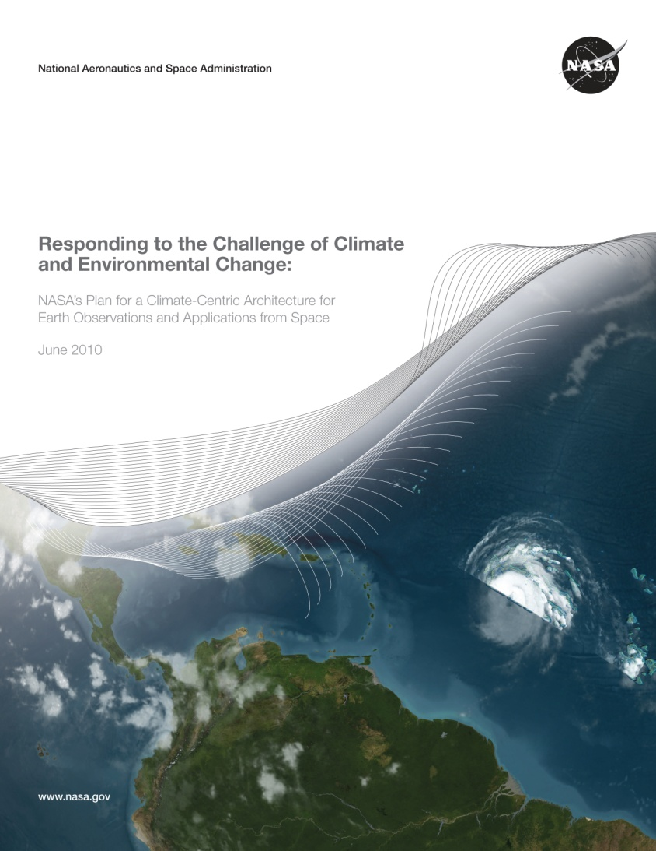
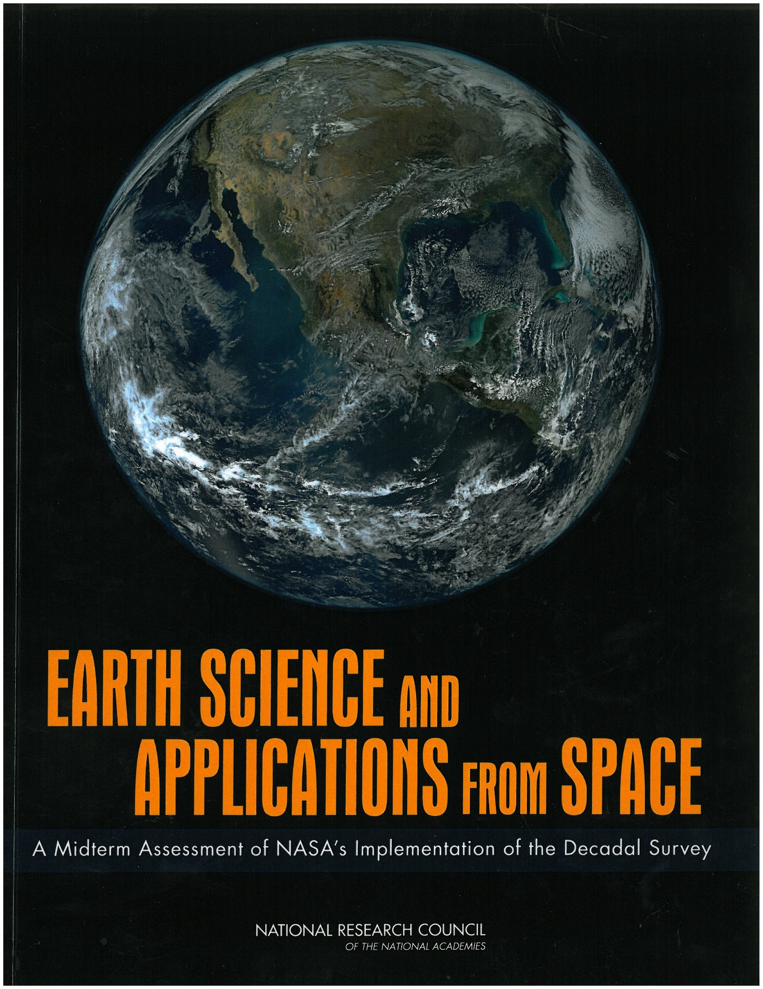
Things change in ten years
2007 Decadal Survey
2010 NASA Response to Climate Plan
2012 NRC Midterm Report
2017 Decadal Survey
Initial NRC Guidance
Updated based on Administration Priorities
Updated with awareness of new environment
Notes:
17

Slide 18
What to expect (hope for) the next Decadal Survey?
Expect (similar to 1st Decadal Survey):
Comprehensive scope, including observations, research, modeling, technology and applications
Awareness of the overall observational environment for NASA Earth Science missions
Hope For (improvements on 1st Decadal Survey):
Enhanced focus on cost credibility in mission and in overall budget projections
More focus on measurement and integrated science investigation objectives and less focus on a specific suite of specific missions

Slide 19
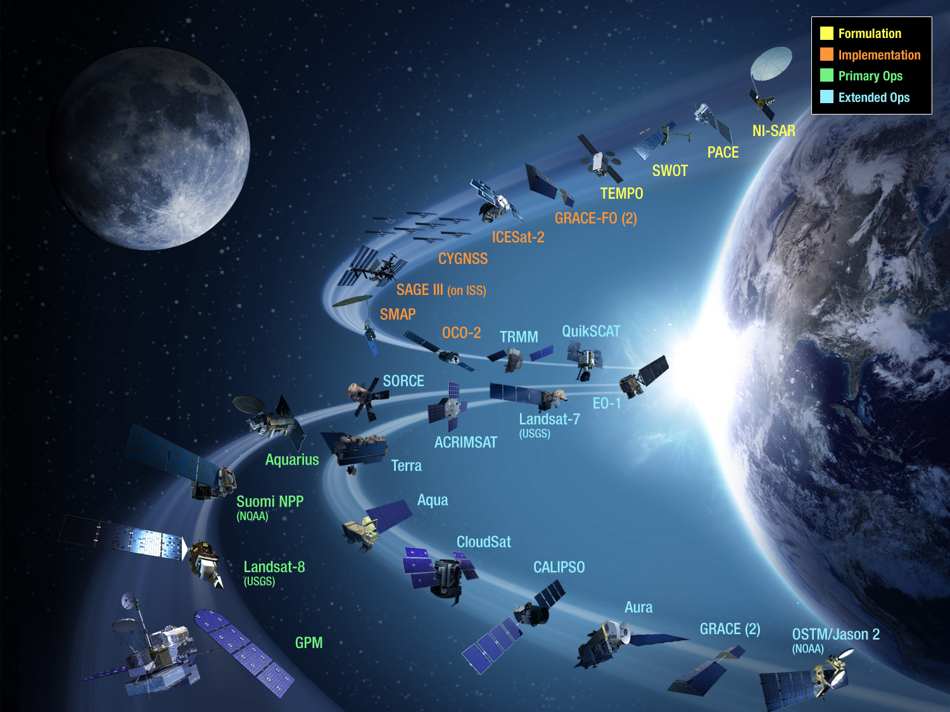


NASA Earth Science Missions
Operating & Planned through 2021
Ozone, Radiation Budget, Solar Irradiance to be defined
Sustainable Land Imaging Satellites to be defined

Slide 20
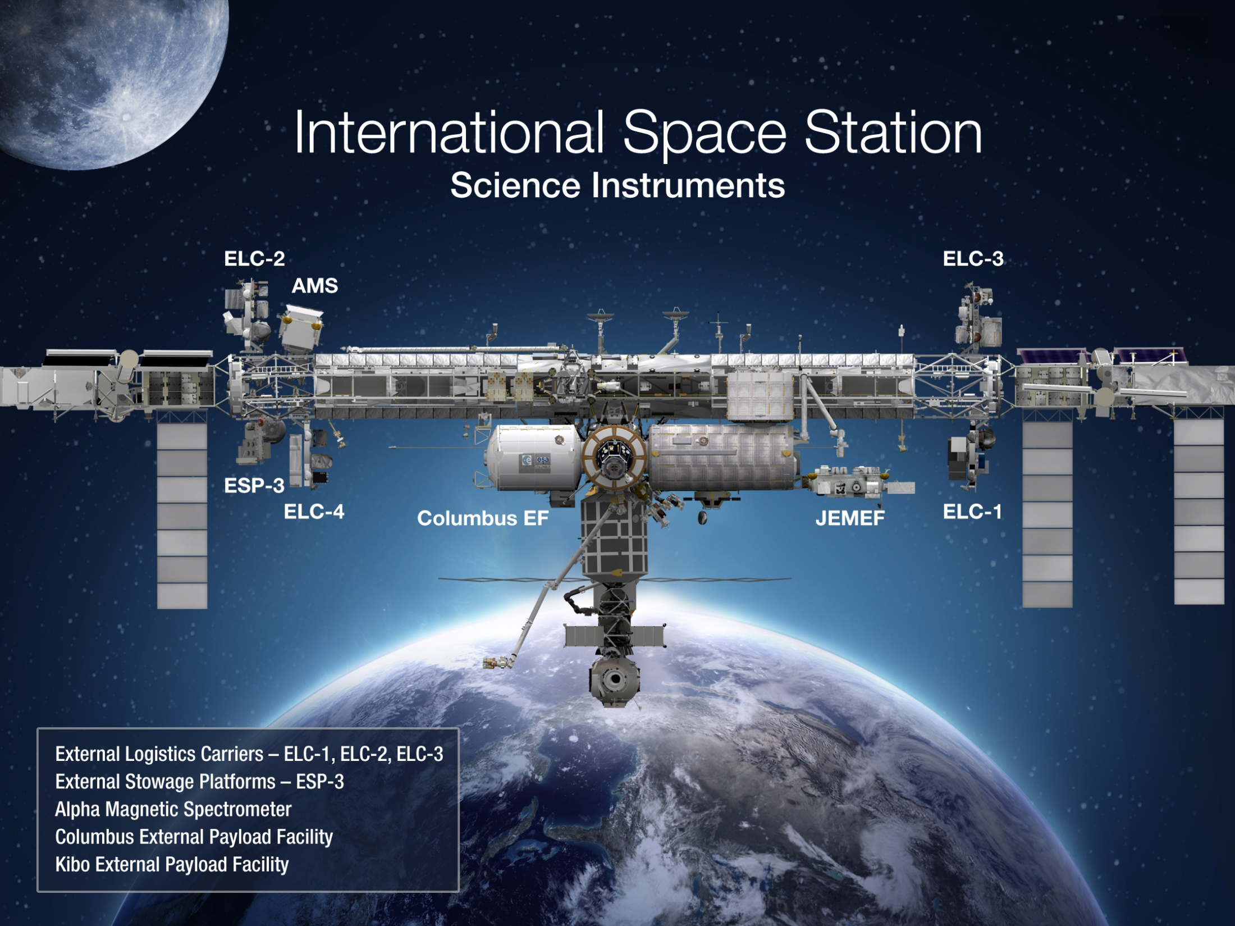
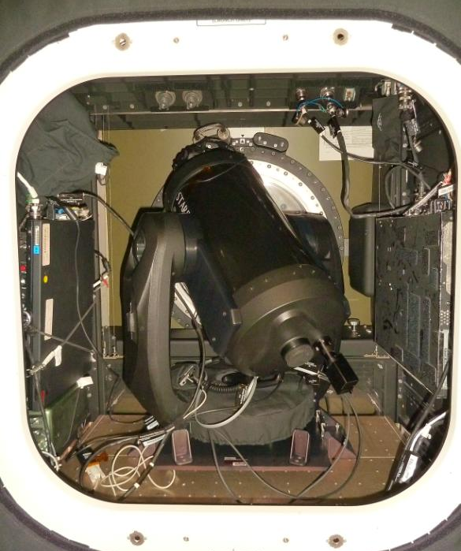
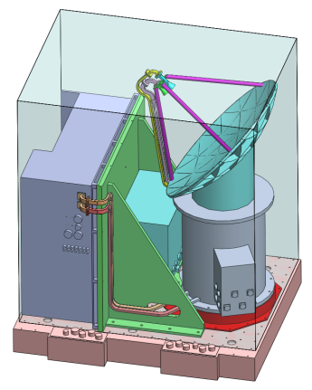
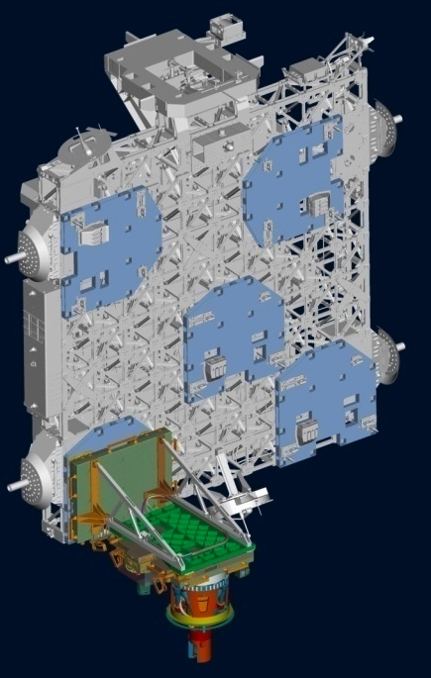
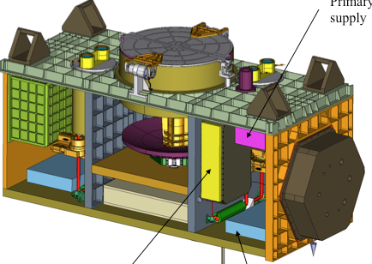
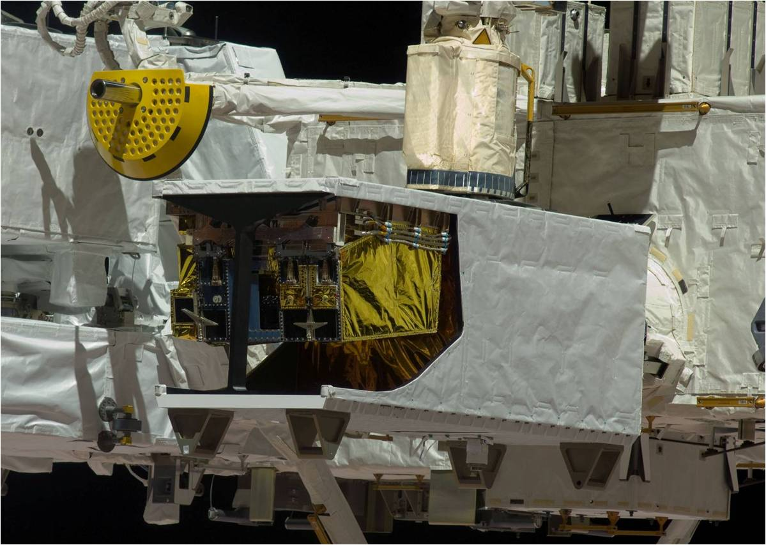
Earth
ISERV
Launch 2012
RapidScat
Launch 2014
LIS (2016)
OCO-3 (TBD)
CATS
Launch 2014
HICO
Launch 2009
SAGE III
Launch 2016

Slide 21
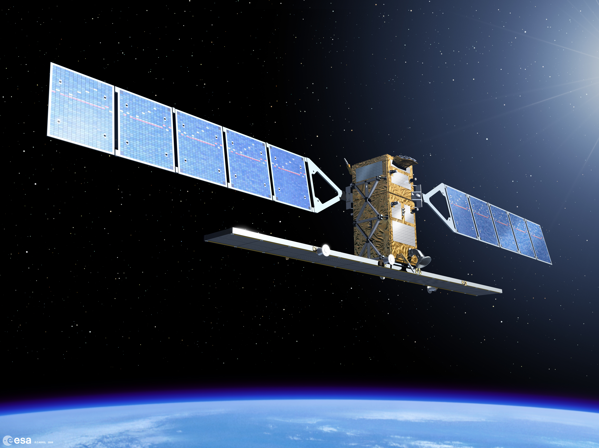
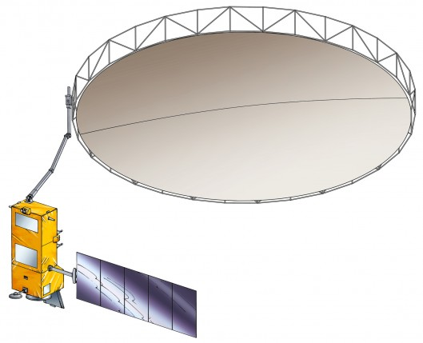
Upcoming SAR missions
Sentinel 1A & B
2014/2015
C-band
P-band
NI-SAR
~2021
BioMASS
~2020
L-band & S-band

Slide 22
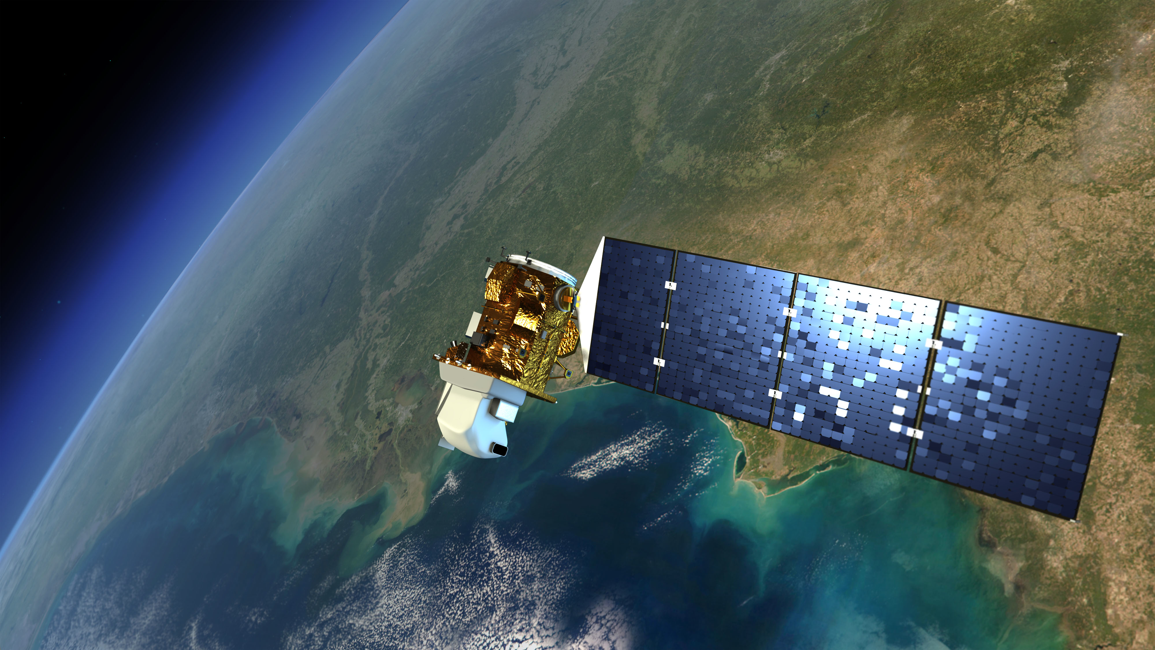
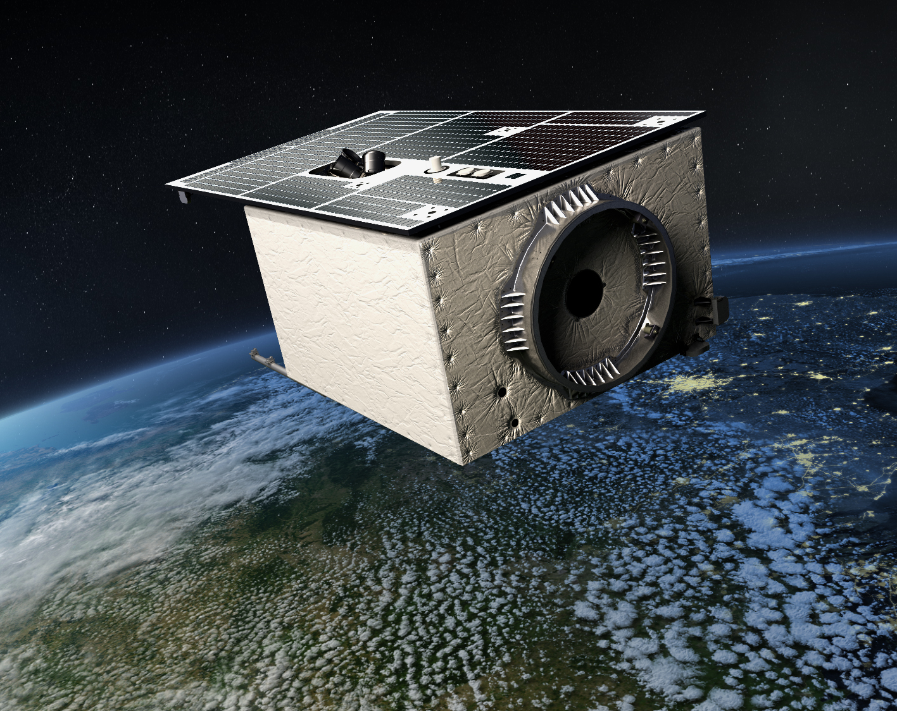

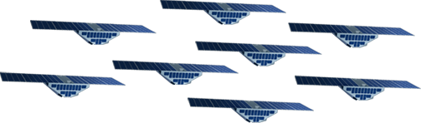

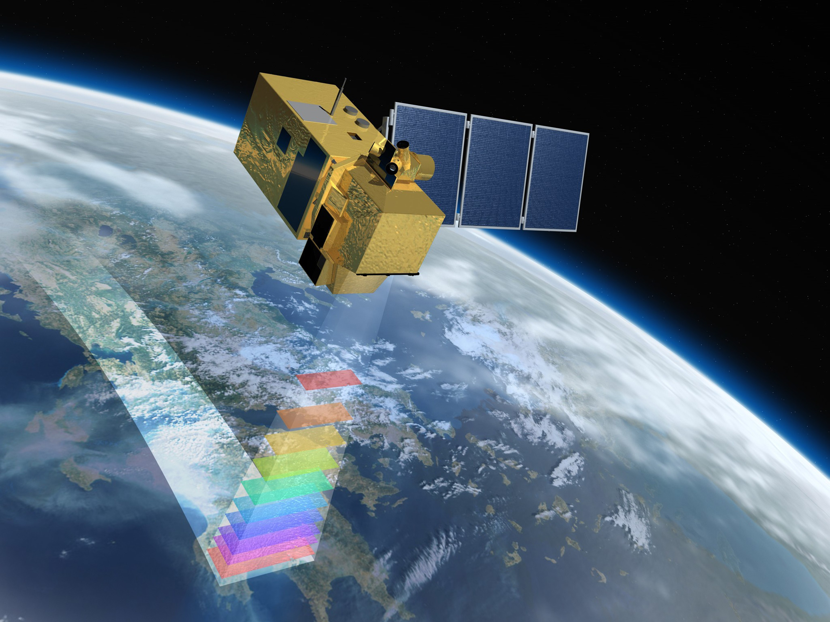



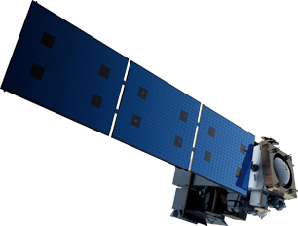
Upcoming/Ongoing Land Imaging Missions
EnMAP
DLR
2017
Landsat 8
2013
Landsat next
2019 and beyond
Sentinel 2A & 2B
2015 & 2017
Terra 1999
Aqua 2002
JPSS-1 2017
JPSS-2 ~2021
S-NPP 2011

Slide 23
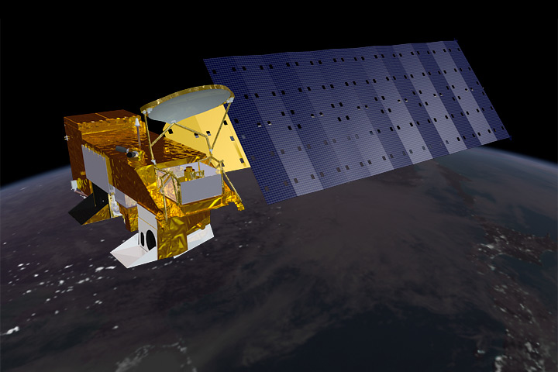
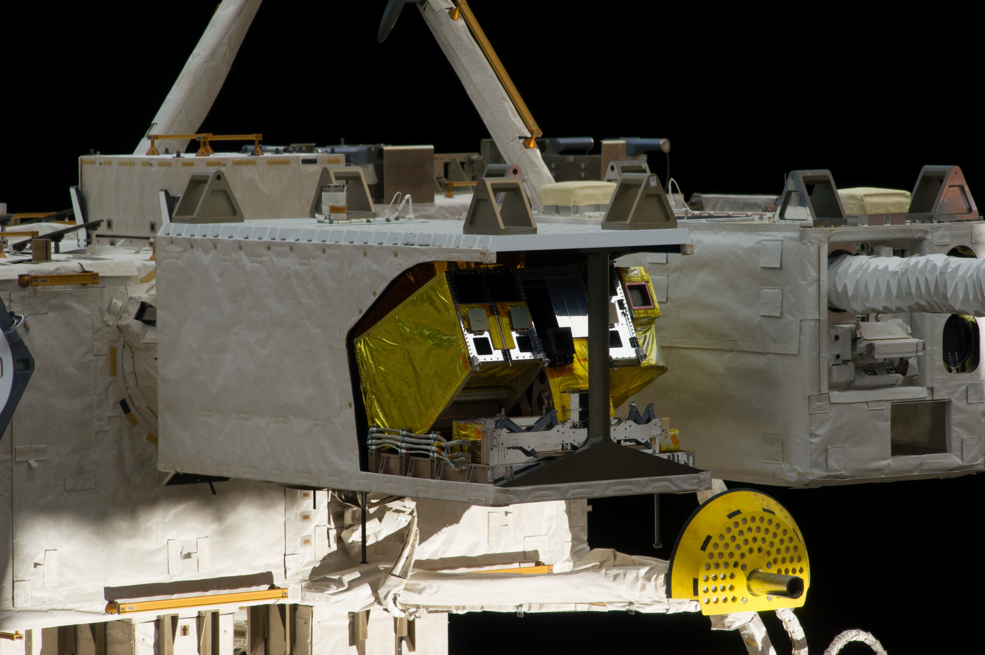
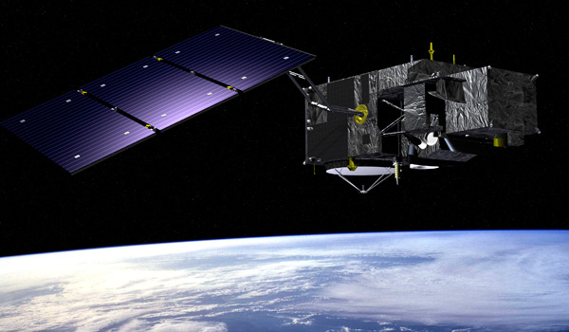
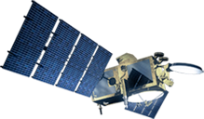
Upcoming/Ongoing Hyperspectral/Ocean Color Missions
Aqua
2002
JPSS-1 2017
S-NPP 2011
JPSS-2 ~2021
HICO on ISS
2009
PACE
~2020
Sentinel 3
~2017

Slide 24
Where are we now?
NASA agrees on a statement of work (SOW) with the NRC of the NAS
  Still working on the SOW, expecting to finish it in the next few months
Notional schedule from here out is:
  Initial announcement ~late 2014
  Discussions, interactions with
  community, 2015
  Report writing, 2016
  Report to NASA, January 2017
Spend this time developing consensus on critical observations
Time phased would be most useful, looking to next 15 years

Slide 25
Questions?

Slide 26
What does the near future look like?
SMAP
ICESat-2
OCO-2
SAGE III
CYGNSS
TEMPO
SWOT
OCO-3
NI-SAR (L-Band SAR)
Transitioned to development
PACE
CLARREO
ASCENDS
ACE
HyspIRI
GEO-CAPE
ROAM
SLI

